Slide 1
INFO6003 Lab-07
Gihan Shamike Liyanage
1142109

Slide 2
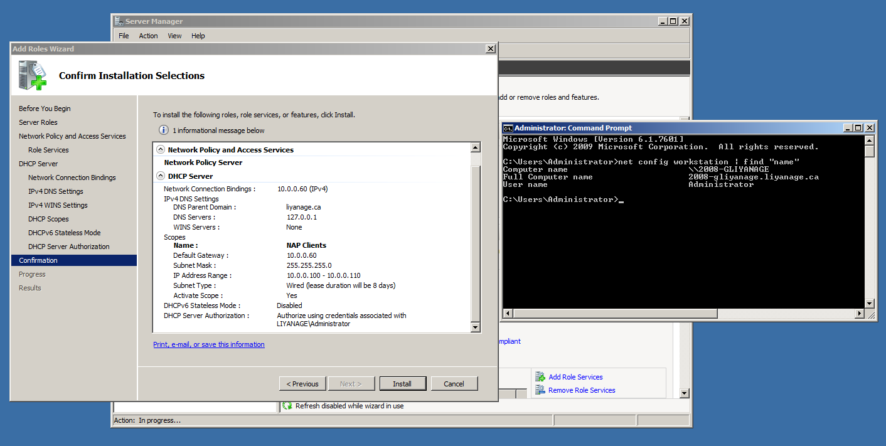
Slide #1

Slide 3
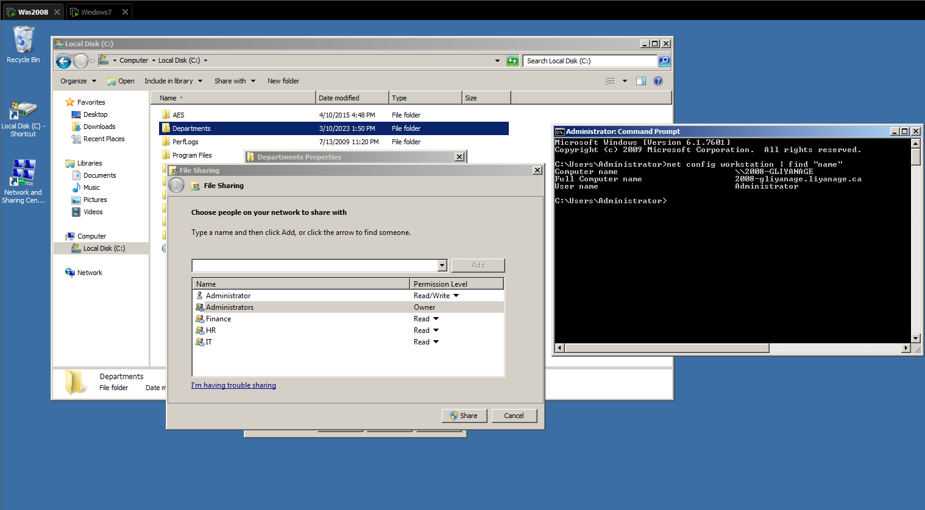
Slide #2

Slide 4
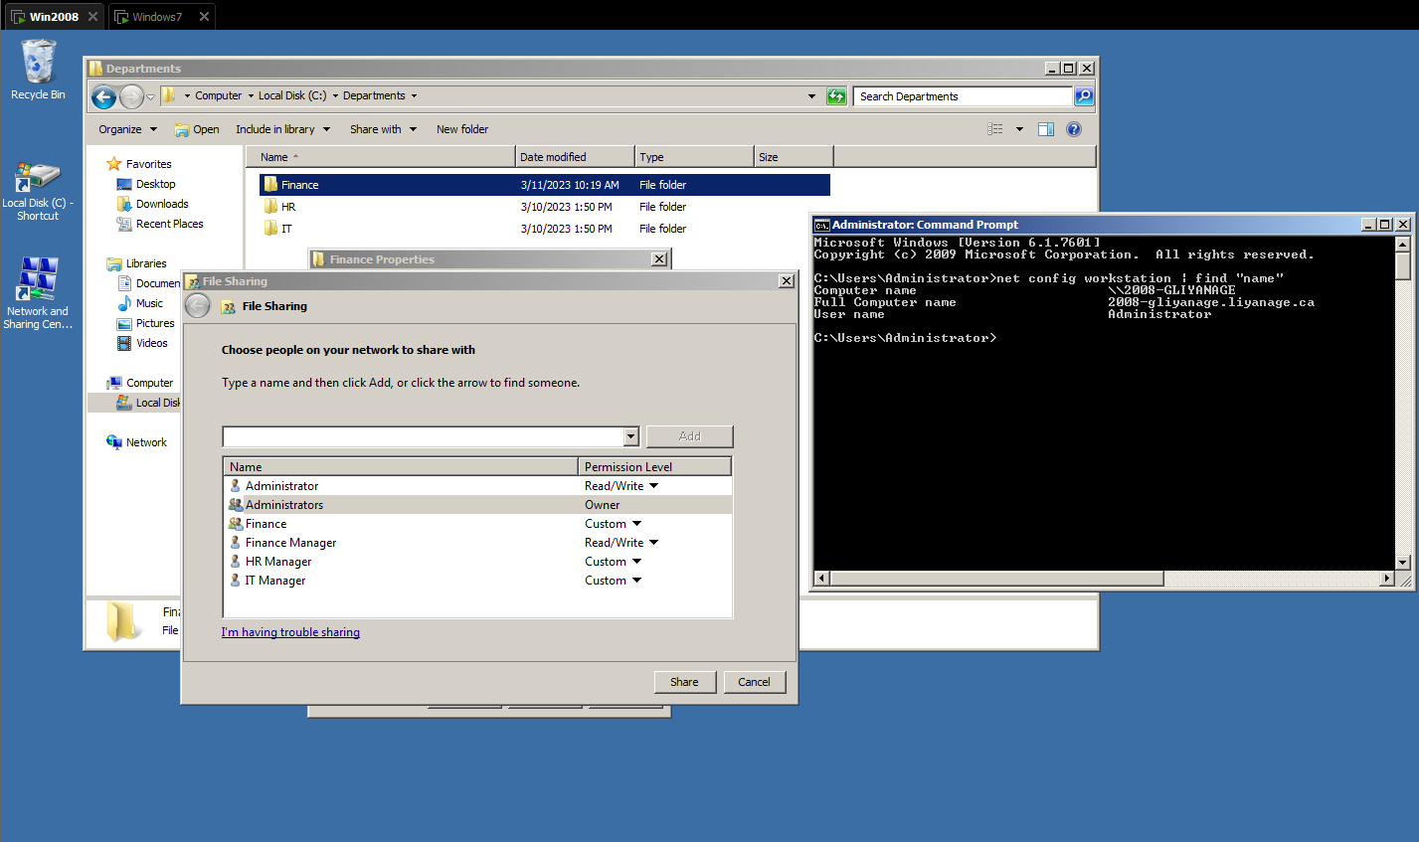
Slide #2

Slide 5
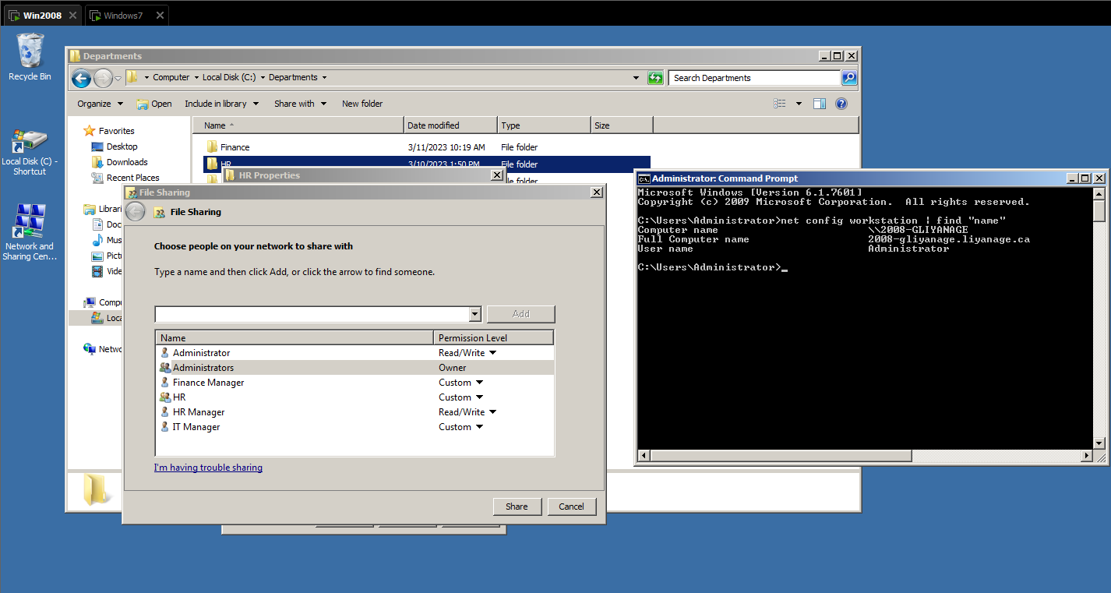
Slide #2

Slide 6
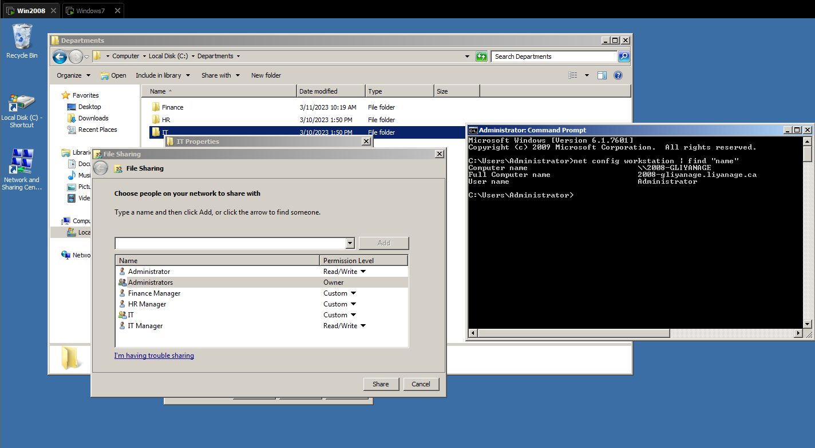
Slide #2

Slide 7
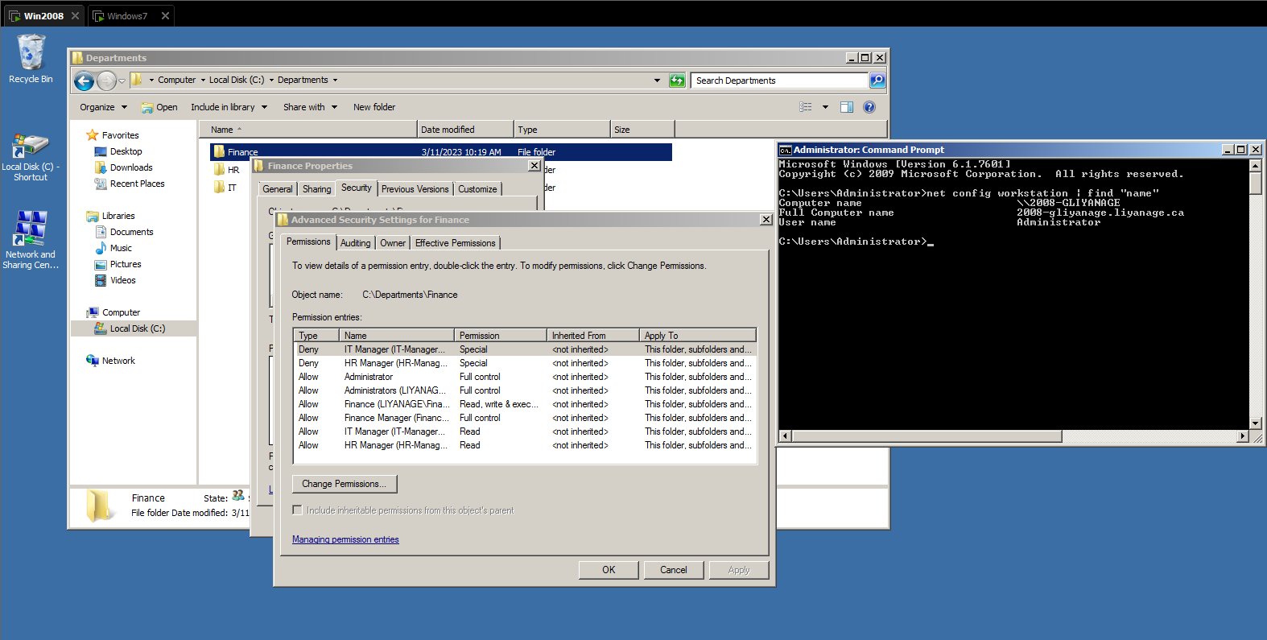
Slide #3

Slide 8
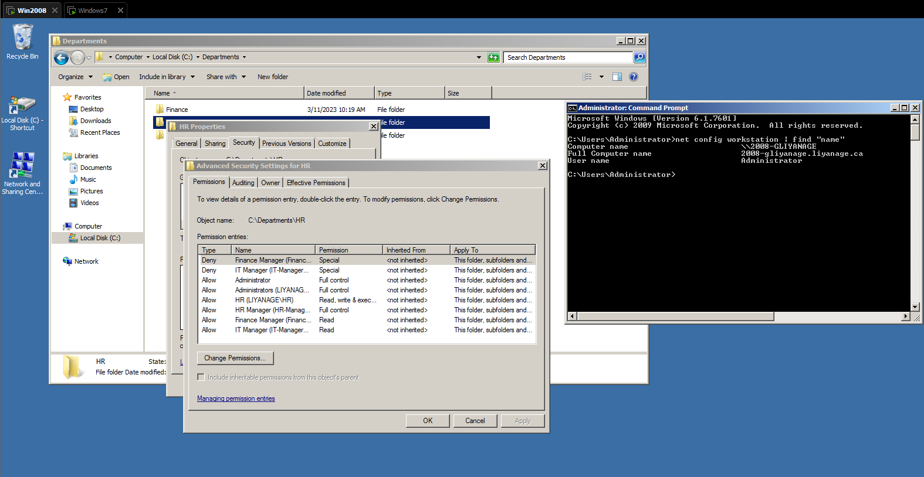
Slide #3

Slide 9
Slide #3

Slide 10
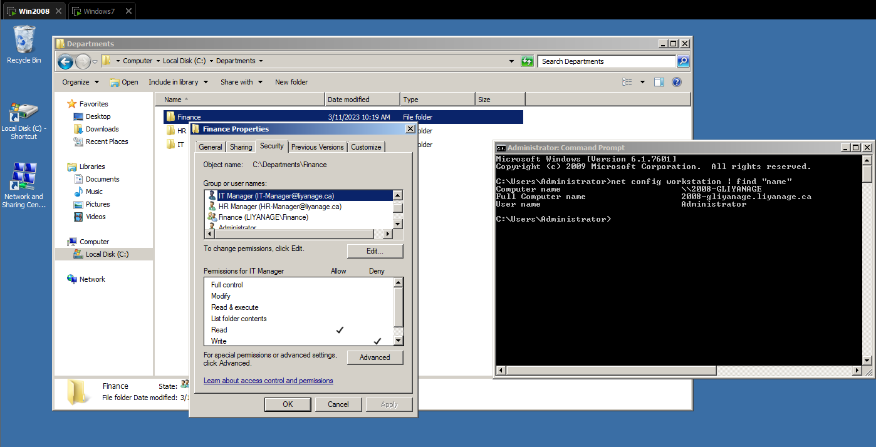
Slide #4

Slide 11
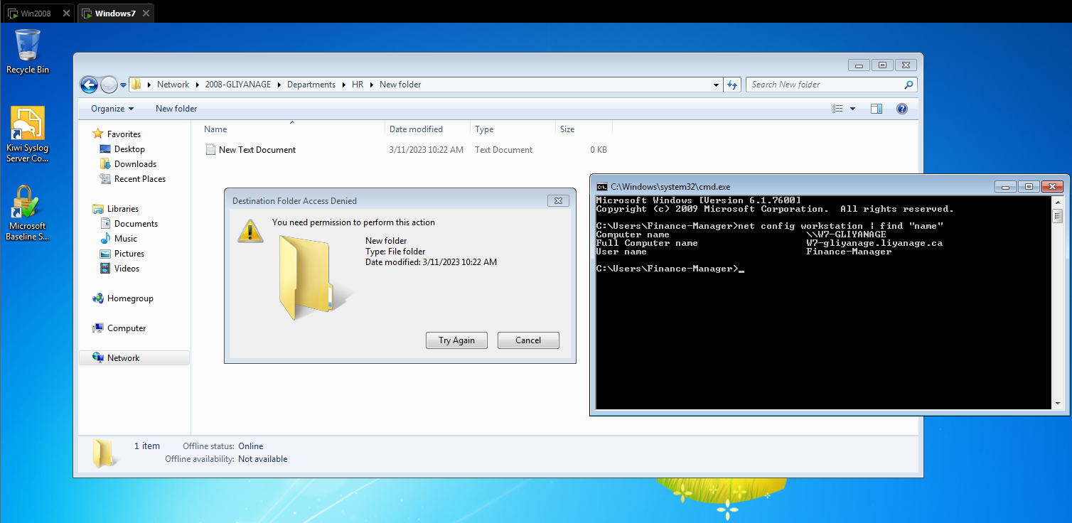
Slide #4

Slide 12
Slide #5

Slide 13
Slide #5

Slide 14
Tell why Deny is not good to use.
Denying access can create complications and issues, such as:
Increased administrative overhead: If you deny access to a user or group, you may need to manually adjust permissions for each individual file or folder that you want them to have access to. This can be time-consuming and create additional administrative overhead.
Difficulty collaborating: If you deny access to a user or group that needs access to a file or folder for collaboration, it can impede productivity and hinder teamwork.
Risk of data loss: If you deny access to a user or group that needs access to a file or folder, they may find alternative methods of accessing the data, such as copying it to an external drive or emailing it to themselves. This can increase the risk of data loss or data breaches.

Slide 15
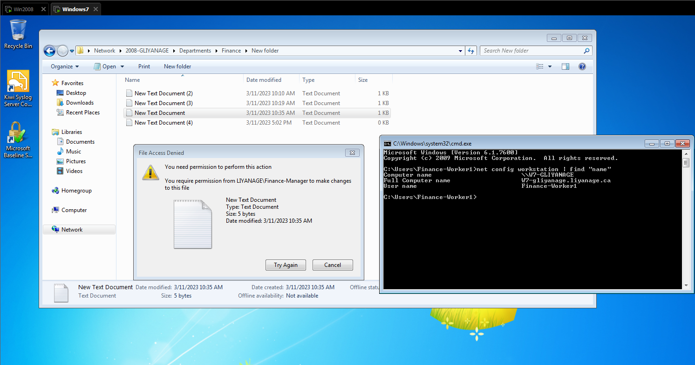
Slide #6

Slide 16
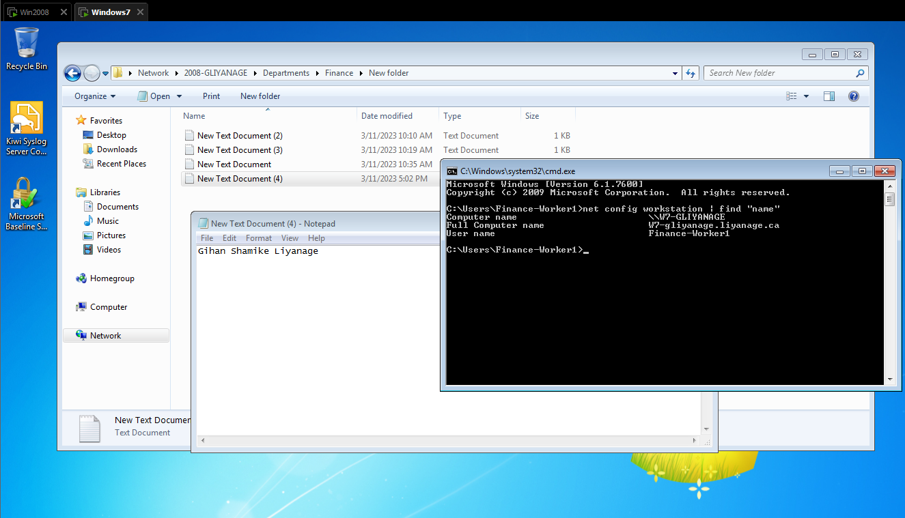
Slide #6

Slide 17
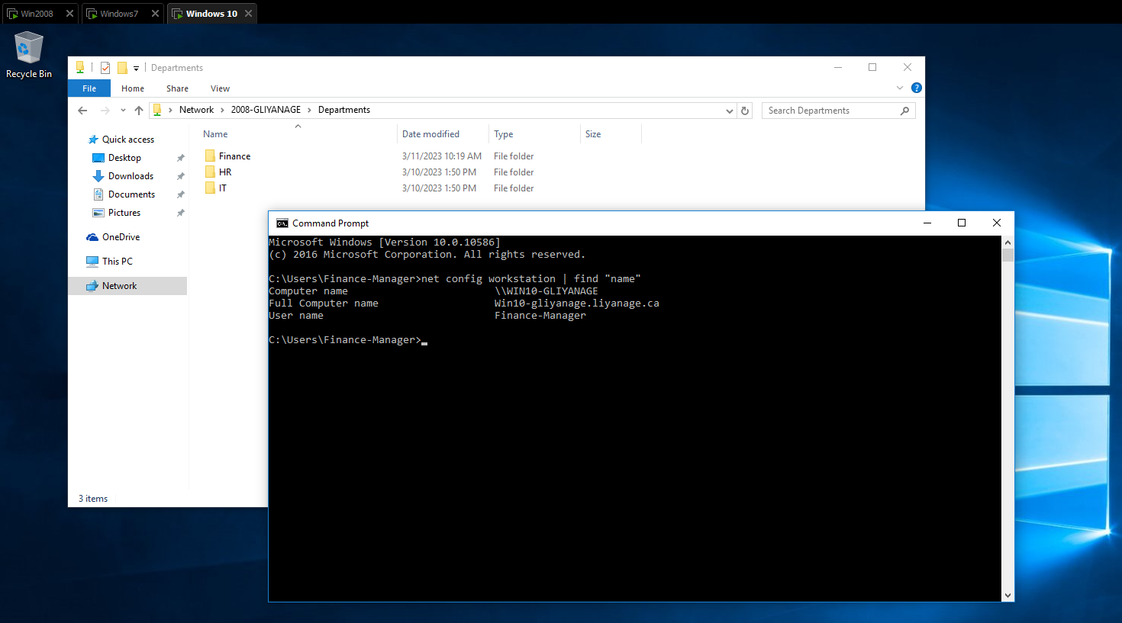
Slide #7

Slide 18
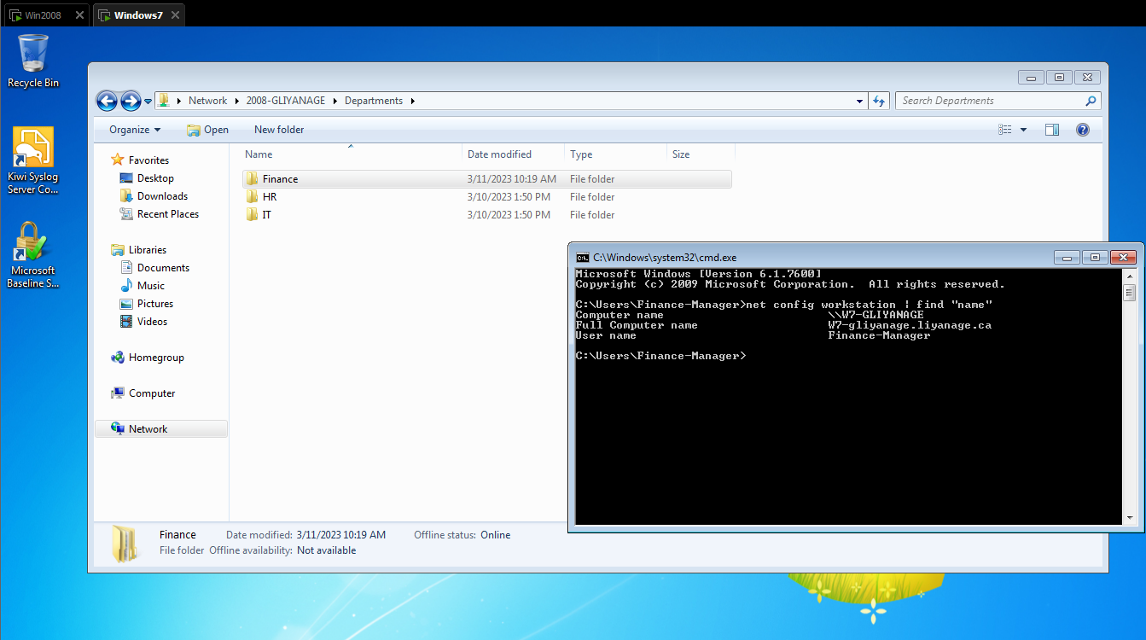
Slide #7

Slide 19
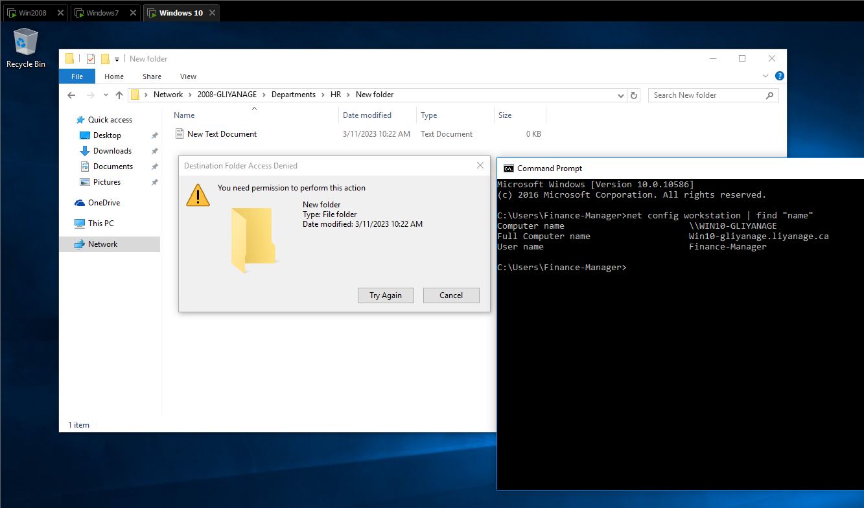
Slide #7

Slide 20
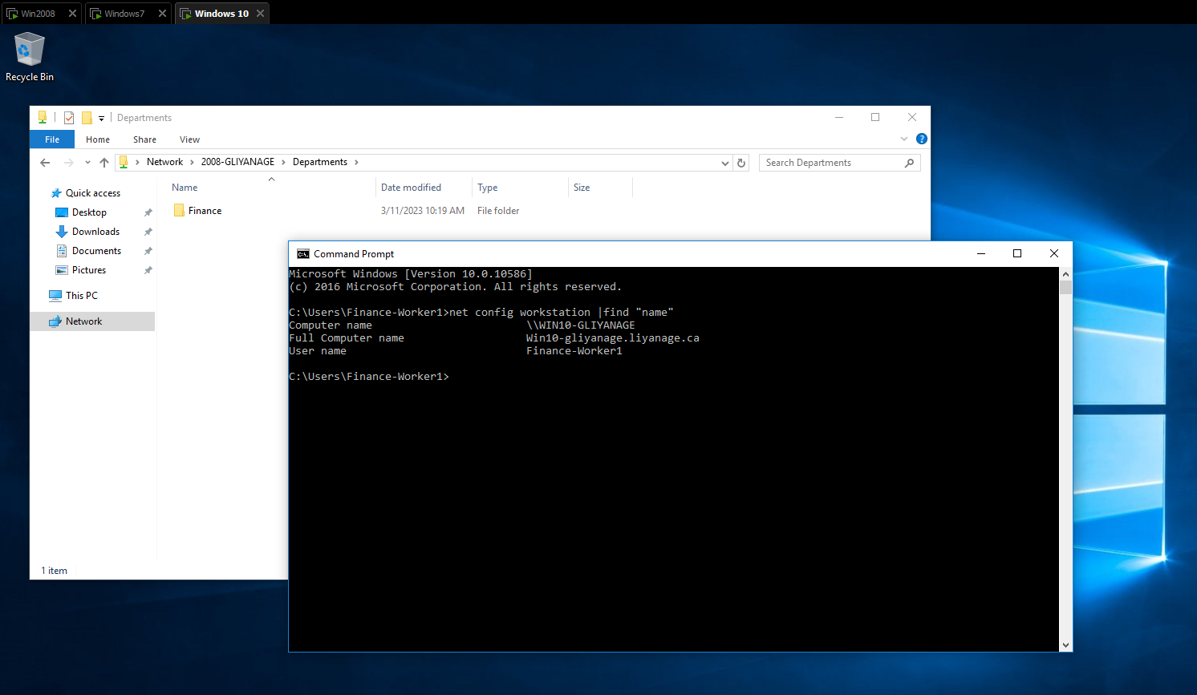
Slide #7

Slide 21
The share permissions are meant for accessing folders over the network, they will not apply for users that log on locally.
They are only applied to the shared folders and are less granular than NTFS permissions, this is why we normally use the NTFS permissions to control folders, sub folders and files.
The most important thing to remember about NTFS permissions and share permissions is the manner in which they combine to regulate access.
The rules for determining a user's level of access to a particular file are as follows:
If the file is accessed locally, only the NTFS permissions are used to determine the user's level of access.
If the file is accessed through a share, NTFS and share permissions are both used, and the most restrictive permission applies. For example, if the share permissions on the shared folder grant the user Read access and the NTFS permissions grant the user Modify access, the user's effective permission level is Read when accessing the share remotely and Modify when accessing the folder locally.
A user's individual permissions combine additively with the permissions of the groups that the user is a member of. If a user has Read access to a file, but the user is a member of a group that has Modify access to the same file, the user's effective permission level is Modify.
Permissions assigned directly to a particular file or folder (explicit permissions) take precedence over permissions inherited from a parent folder (inherited permissions).
Explicit Deny permissions take precedence over explicit Allow permissions, but because of the previous rule, explicit Allow permissions take precedence over inherited Deny permissions.

Slide 22
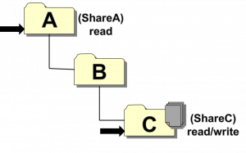
Let’s say that the share permissions on ShareA are set to everyone read, and the share permissions on ShareC are set to everyone read + write.
Let’s also assume that NTFS permissions on all files are open to everyone. When you access a share over the network, you typically either “map a drive,” or type an address into windows explorer.
Either way, you’re accessing a share via what’s known as a UNC path, which looks like this: \\[ServerName]\[Sharename]\[folders]\[files] So, if you want to create or look at some files in folder C, you can access them in two (2) ways:
\\foo\shareC\
\\foo\shareA\B\C\
Since the share permissions set on ShareC are read + write, you’ll be able to read and write files in C if you access the files using the first path, but you’ll only be able to read files if you access them via the second path.

